Slide 2
Abstract Classes and Interfaces in OOP
Data abstraction is the process of hiding certain details and showing only essential information to the user. Abstraction can be achieved with either abstract classes or interfaces.
Abstract Classes:
An abstract class is a class that cannot be instantiated on its own. It serves as a blueprint (Provide a way to define a standard set of behaviors and features that multiple classes can share without implementing them from scratch. These classes can create a foundation upon others to build, allowing developers to quickly create new classes with minimal effort) for other classes.
Abstract classes may have abstract methods (methods without implementations) and concrete methods (methods with implementations).
Subclasses of an abstract class are required to provide implementations for all the abstract methods.
Abstract classes can have instance variables and constructors.

Slide 3
In Java, the following some important observations about abstract classes are as follows:
An instance of an abstract class can not be created.
Constructors are allowed.
We can have an abstract class without any abstract method.
There can be a final method in abstract class but any abstract method in class(abstract class) can not be declared as final or in simpler terms final method can not be abstract itself as it will yield an error: “Illegal combination of modifiers: abstract and final”
We can define static methods in an abstract class
We can use the abstract keyword for declaring top-level classes (Outer class) as well as inner classes as abstract
If a class contains at least one abstract method then compulsory should declare a class as abstract
If the Child class is unable to provide implementation to all abstract methods of the Parent class then we should declare that Child class as abstract so that the next level Child class should provide implementation to the remaining abstract method

Slide 4
Abstract class having constructor, data member and methods
//example of abstract class that have method body abstract class Bike{ Bike(){ // Constructor System.out.println("bike is created"); } abstract void run(); // abstract method void changeGear(){ // Normal method System.out.println("gear changed"); } } class Honda extends Bike{ void run(){System.out.println("running safely.."); } } | class TestAbstraction2{ public static void main(String args[]){ Bike obj = new Honda(); obj.run(); obj.changeGear(); } } Output: bike is created running safely.. gear changed class Bike12{ // what will be output abstract void run(); }
Rule:
If there is an abstract method in a class, that class must be abstract.

Slide 5
abstract class Calculator { abstract void display(); } class Add extends Calculator { void display() { System.out.println("In the Add Child Class"); } } class Sub extends Calculator { void display() { System.out.println("In the Sub Child Class"); } } | class AbstractMethodExample { public static void main(String arg[]) { Calculator add = new Add(); add.display(); Calculator sub = new Sub(); sub.display(); } } Output: In the Add Child Class In the Sub Child Class

Slide 6
// Abstract class abstract class Sunstar { abstract void printInfo(); } // Abstraction performed using extends class Employee extends Sunstar { void printInfo() { String name = “AAshish"; int age = 8; float salary = 222.2F; System.out.println(name); System.out.println(age); System.out.println(salary); } } | // Base class class Base { public static void main(String args[]) { Sunstar s = new Employee(); s.printInfo(); } } Output: AAshish 8 222.2

Slide 7
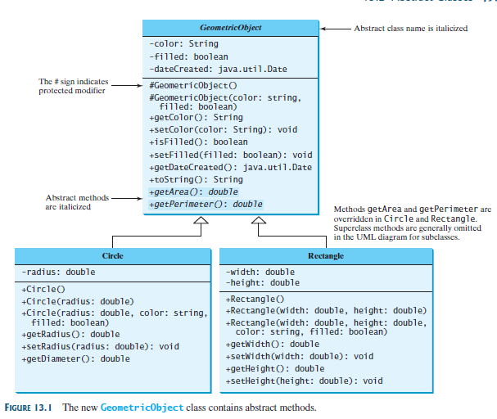
An Abstract class name and Abstract methods are capitalized in the class diagram.
GeometricObject is an Abstract class.
getArea() and getPerimeter() are Abstract methods.

Slide 8
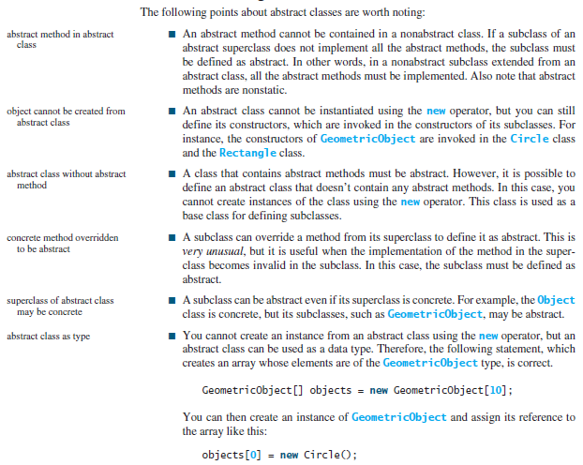

Slide 9
Interfaces
The interface in Java is a mechanism to achieve abstraction.
An interface is a blueprint of a class. It has static constants and abstract methods.
There can be only abstract methods in the Java interface, not the method body.
It is used to achieve abstraction and multiple inheritances in Java using Interface.
In other words, you can say that interfaces can have abstract methods and variables. It cannot have a method body.
Interface methods are by default abstract and public.
Interface attributes are by default public, static and final.
A class can implement multiple interfaces, allowing it to inherit behavior from multiple sources.
Classes implement interfaces using the ‘implements’ keyword.

Slide 10
Why And When To Use Interfaces?
To achieve security - hide certain details and only show the important details of an object (interface).
2) Java does not support "multiple inheritance" (a class can only inherit
from one superclass). However, it can be achieved with interfaces,
because the class can implement multiple interfaces.
Note: To implement multiple interfaces, separate them with a comma.
How to declare an interface
interface <interface_name>{
// declare constant fields
// declare methods that abstract by default.
}

Slide 11
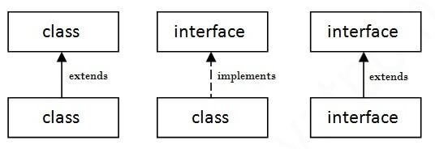
The relationship between classes and interfaces
As shown in the figure given below, a class extends another class, an interface extends another interface, but a class implements an interface.

Slide 12
Example to demonstrate interface :
import java.io.*; interface Animal { // interface methods (does not have a body) public void animalSound(); public void sleep(); } class Cow implements Animal { public void animalSound() { System.out.println("The cow says: Amba Amba"); } public void sleep() { System.out.println("Zzz..i am sleepy"); }} | class Main { public static void main(String[] args) { Cow myCow = new Cow(); myCow.animalSound(); myCow.sleep(); } } Output: The cow says: Amba Amba Zzz… I am sleepy
Interface methods are by default abstract and public

Slide 13
Example to demonstrate Multiple interfaces :
interface FirstInterface { public void myMethod(); // interface method } interface SecondInterface { public void myOtherMethod(); // interface method } // DemoClass "implements" FirstInterface and SecondInterface class DemoClass implements FirstInterface, SecondInterface { public void myMethod() { System.out.println("First Interface.."); } public void myOtherMethod() { System.out.println("Second Interface..."); } } | class Main { public static void main(String[] args) { DemoClass myObj = new DemoClass(); myObj.myMethod(); myObj.myOtherMethod(); } } Output: First Interface.. Second Interface...

Slide 14
interface Animal { void eat(); } interface Bird { void fly(); }// Multiple inheritance class Sparrow implements Animal, Bird { public void eat() { System.out.println("Sparrow is eating"); } public void fly() { System.out.println("Sparrow is flying"); } } | public class Main { public static void main(String[] args) { Sparrow sp = new Sparrow(); sp.eat(); sp.fly(); }} Output Sparrow is eating Sparrow is flying

Slide 15
Multiple inheritance is not supported through class in java, but it is possible by an interface, why?
Multiple inheritance is not supported in the case of class because of ambiguity. However, it is supported in case of an interface because there is no ambiguity. It is because its implementation is provided by the implementation class.
interface Printable{ void print(); } interface Showable{ void print(); } class TestInterface3 implements Printable, Showable{ public void print(){ System.out.println(“Amrita"); } | public static void main(String args[]){ TestInterface3 obj = new TestInterface3(); obj.print(); } } Output: Amrita

Slide 16
Interface Inheritance
A class implements an interface, but one interface extends another interface.
interface Printable{ void print(); } interface Showable extends Printable{ void show(); } class TestInterface4 implements Showable{ public void print(){ System.out.println("Hello"); } void show(){ System.out.println("Welcome"); } | public static void main(String args[]){ TestInterface4 obj = new TestInterface4(); obj.print(); obj.show(); } } Output: Hello Welcome

Slide 17
Default Method in Interface
We can have method body in interface. But we need to make it default method.
interface Drawable{ void draw(); default void msg(){ System.out.println("default method"); } } class Rectangle implements Drawable{ public void draw(){ System.out.println("drawing rectangle");} } | class TestInterfaceDefault{ public static void main(String args[]){ Drawable d=new Rectangle(); d.draw(); d.msg(); } } Output: drawing rectangle default method

Slide 18
Q. Consider the example of vehicles like bicycles, cars, bikes, etc they have common functionalities. So we make an interface and put all these common functionalities. And lets Bicycle, Bike, car, etc implement all these functionalities in their own class in their own way.
import java.io.*; interface Vehicle { // all are the abstract methods. void changeGear(int a); void speedUp(int a); void applyBrakes(int a); } class Bicycle implements Vehicle{ int speed; int gear; @Override public void changeGear(int newGear){ gear = newGear; } // to change gear @Override public void speedUp(int increment){ speed = speed + increment; } // to increase speed | @Override public void applyBrakes(int decrement){ speed = speed - decrement; } // to decrease speed public void printStates() { System.out.println("speed: " + speed+ " gear: " + gear); } } class Bike implements Vehicle { int speed; int gear; @Override public void changeGear(int newGear){ gear = newGear; } // to change gear @Override public void speedUp(int increment){ speed = speed + increment; } // to increase speed

Slide 19
// to decrease speed @Override public void applyBrakes(int decrement){ speed = speed - decrement; public void printStates() { System.out.println("speed: " + speed+ " gear: " + gear); } } class GFG { public static void main (String[] args) { // creating an instance of Bicycle // doing some operations Bicycle bicycle = new Bicycle(); bicycle.changeGear(2); bicycle.speedUp(3); bicycle.applyBrakes(1); | System.out.println("Bicycle present state :"); bicycle.printStates(); // creating instance of the bike. Bike bike = new Bike(); bike.changeGear(1); bike.speedUp(4); bike.applyBrakes(3); System.out.println("Bike present state :"); bike.printStates(); } } Output: Bicycle present state : speed: 2 gear: 2 Bike present state : speed: 1 gear: 1

Slide 20
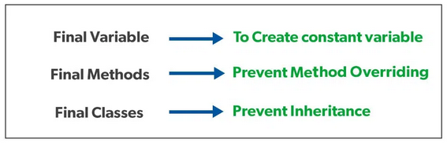
The final method in Java is used as a non-access modifier applicable only to a variable, a method, or a class. It is used to restrict a user in Java.
The following are different contexts where the final is used:
Variable
Method
Class
Final variables: When a variable is declared as final, its value cannot be changed once it has been initialized. This is useful for declaring constants or other values that should not be modified.
Final methods: When a method is declared as final, it cannot be overridden by a subclass. This is useful for methods that are part of a class’s public API and should not be modified by subclasses.
Final classes: When a class is declared as final, it cannot be extended by a subclass. This is useful for classes that are intended to be used as it is and should not be modified or extended.

Slide 21
// Java program to show that interfaces can // have methods from JDK 1.8 onwards interface In1{ final int a = 10; default void display() { System.out.println("hello"); } } // A class that implements the interface. class TestClass implements In1{ // Driver Code public static void main (String[] args) { TestClass t = new TestClass(); t.display(); }} Output: hello

Slide 22
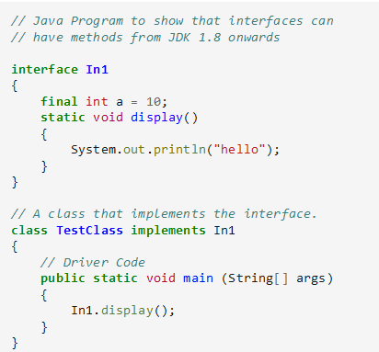
Another feature that was added in JDK 8 is that we can now define static methods in interfaces that can be called independently without an object.
Note: these methods are not inherited.
hello

Slide 23
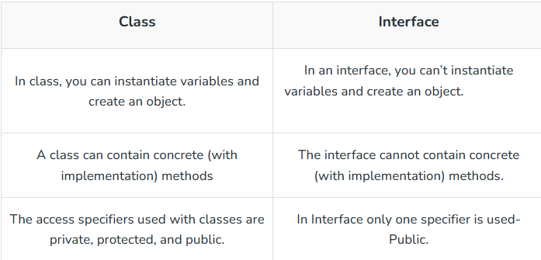
Difference Between Class and Interface

Slide 24
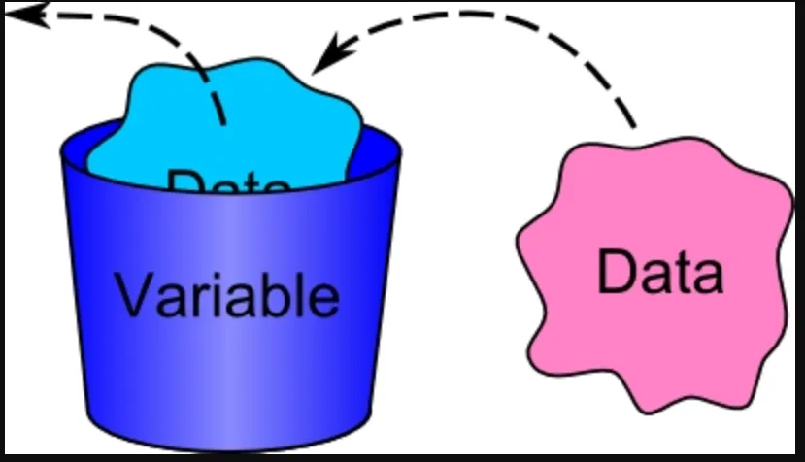
Local and Global (or class)
Local Variable:
Local variables are variables that are declared within a specific scope, such as within a function or a block of code.
These variables are only accessible within that particular scope and are typically used for temporary storage of data or for performing calculations within a limited context.
Once the scope in which a local variable is defined ends, the variable typically goes out of scope and its memory is released.
In many programming languages, local variables have a limited visibility and lifespan compared to global variables, which are accessible from any part of the program.
This encapsulation of variables within specific scopes helps to organize code, prevent unintended modifications, and manage memory efficiently.

Slide 25
Global Variable:
Global variables are variables that are declared outside of any function or block of code and can be accessed from any part of the program.
Unlike local variables, which have limited scope, global variables have a broader scope and can be used across multiple functions, modules, or files within a program.
Static Variable:
When a variable is defined as static, then a single copy of the variable is created and shared among all objects at the class level. Static variables are, essentially, global variables.
All instances of the class share the same static variable.
Important points for static variables:
We can create static variables at class-level only.
Static block and static variables are executed in order they are present in a program.
Static variable can call by directly with the help of class only, we do not need to create object for the class in this.

Slide 26
public class VariableExample { // Global (Instance) variable int globalCount = 10; void display() { // Local variable int localCount = 5; System.out.println("Local Count: " + localCount); System.out.println("Global Count: " + globalCount); } void update() { // Another method that can access the global variable globalCount += 5; System.out.println("Updated Global Count: " + globalCount); } public static void main(String[] args) { VariableExample obj = new VariableExample(); obj.display(); obj.update(); }} | Output: Local Count: 5 Global Count: 10 Updated Global Count: 15 globalCount is a global variable (instance variable) because it is declared at the class level and shared among all methods. localCount is a local variable because it is declared inside the display() method and only accessible there. Attempting to use localCount in another method like update() would result in a compile-time error.

Slide 27
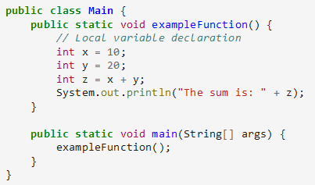
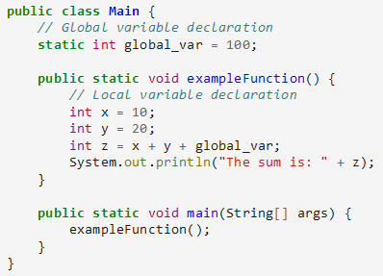
Local
Global
The sum is: 30
The sum is: 130

Slide 28
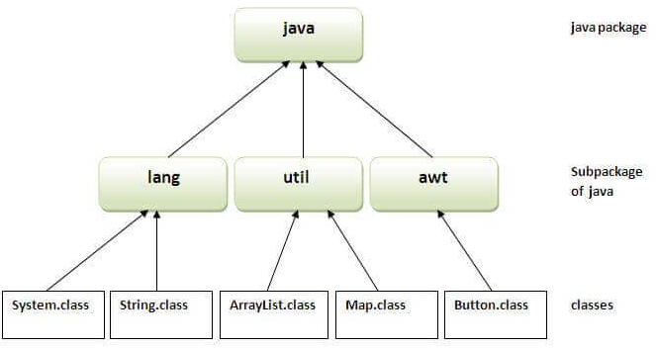
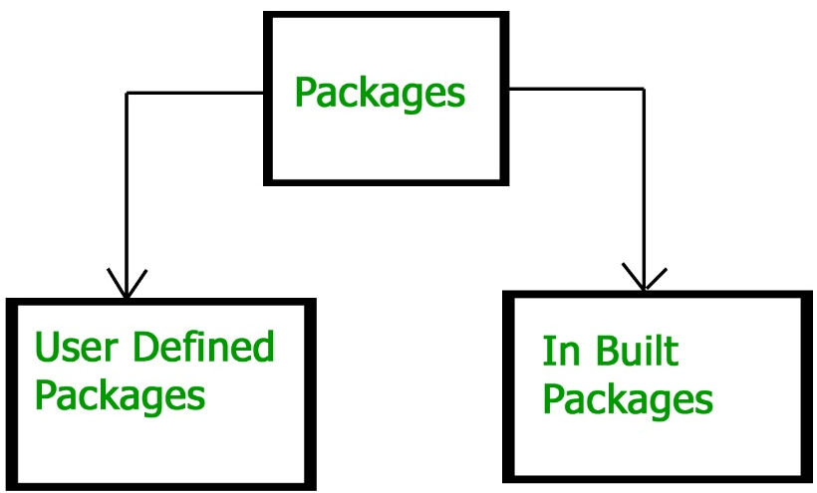
Packages
A java package is a group of similar types of classes, interfaces and sub-packages.
Advantage of Java Package
Java package is used to categorize the classes and interfaces so that they can be easily maintained.
Java package provides access protection.
Java package removes naming collision.
Package in java can be categorized in two forms, built-in package and user-defined package.

Slide 29
Built-in Packages
These packages consist of a large number of classes which are a part of Java API. Some of the commonly used built-in packages are:
java.lang: Contains language support classes(e.g classes which defines primitive data types, math operations). This package is automatically imported.
java.io: Contains classes for supporting input / output operations.
java.util: Contains utility classes which implement data structures like Linked List, Dictionary and support ; for Date / Time operations.
java.applet: Contains classes for creating Applets.
java.awt: Contain classes for implementing the components for graphical user interfaces (like button, menus etc).
java.net: Contain classes for supporting networking operations.

Slide 30
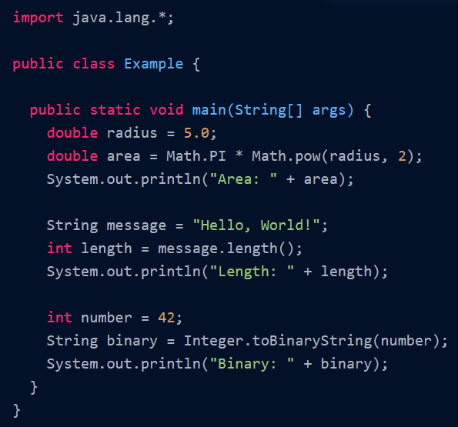
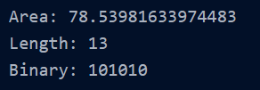
Importing java.lang
Output
Explanation:
In this example, we import java.lang.* to have access to some of the fundamental classes provided by Java, such as Math, String, and Integer.
The code demonstrates the usage of these classes by calculating the area of a circle, determining the length of a string, and converting an integer to its binary representation.

Slide 31
User-defined packages are those that the users define.
Inside a package, you can have Java files like classes, interfaces, and a package as well (called a sub-package).
How to access package from another package?
There are three ways to access the package from outside the package.
import package.*;
import package.classname;
fully qualified name.
1) Using packagename.*
If you use package.* then all the classes and interfaces of this package will be accessible but not sub packages.
The import keyword is used to make the classes and interface of another package accessible to the current package.

Slide 32
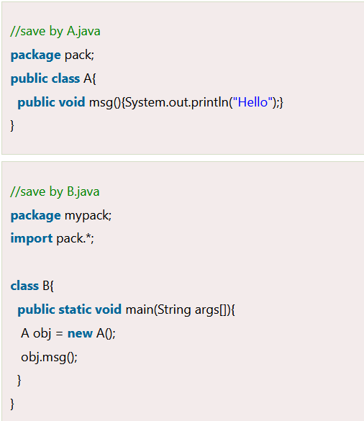
Output:Hello

Slide 33
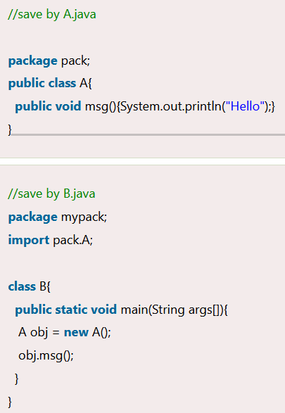
2) Using packagename.classname
If you import package.classname then only declared class of this package will be accessible.
Note: If you import a package, subpackages will not be imported.
Output:Hello

Slide 34
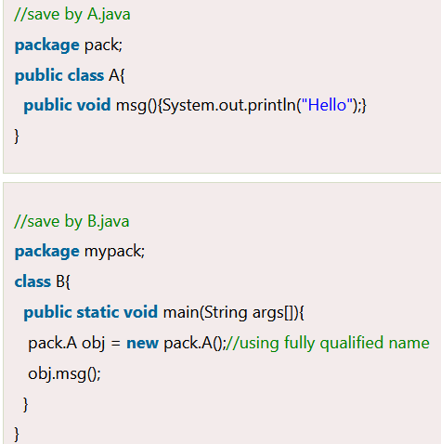
3) Using fully qualified name
If you use fully qualified name then only declared class of this package will be accessible. Now there is no need to import. But you need to use fully qualified name every time when you are accessing the class or interface.
It is generally used when two packages have same class name e.g. java.util and java.sql packages contain Date class.
If you import a package, all the classes and interface of that package will be imported excluding the classes and interfaces of the subpackages. Hence, you need to import the subpackage as well.
Output:Hello

Slide 35
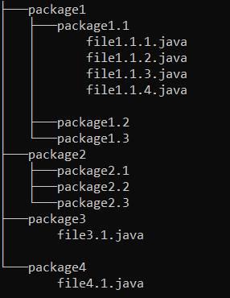
Subpackage in Java
A package defined inside a package is called a sub-package. It’s used to make the structure of the package more generic. It lets users arrange their Java files into their corresponding packages.
For example, say, you have a package named cars. You’ve defined supporting Java files inside it.
But now you want to define another package called superCars. Should we define it inside the car's package or outside as another package? At this point, you must say that it should go inside cars because superCars are also related to cars.
But to be more generic, we’re defining it as a separate package, but having it inside cars makes them part of cars.

Slide 36
UNIT 3

Slide 37
Exceptions
Introduction:
Exception handling enables a program to deal with exceptional situations and continue its normal execution.
Exception Handling in Java is one of the effective means to handle runtime errors so that the regular flow of the application can be preserved.
It is a mechanism to handle runtime errors such as ClassNotFoundException, IOException, InputMismatchException, ArrayIndexOutOfBoundsException, etc.
What are Java Exceptions?
An Exception is an unwanted or unexpected event, which occurs during the execution of a program, i.e. at run time, that disrupts the normal flow of the program’s instructions.

Slide 38
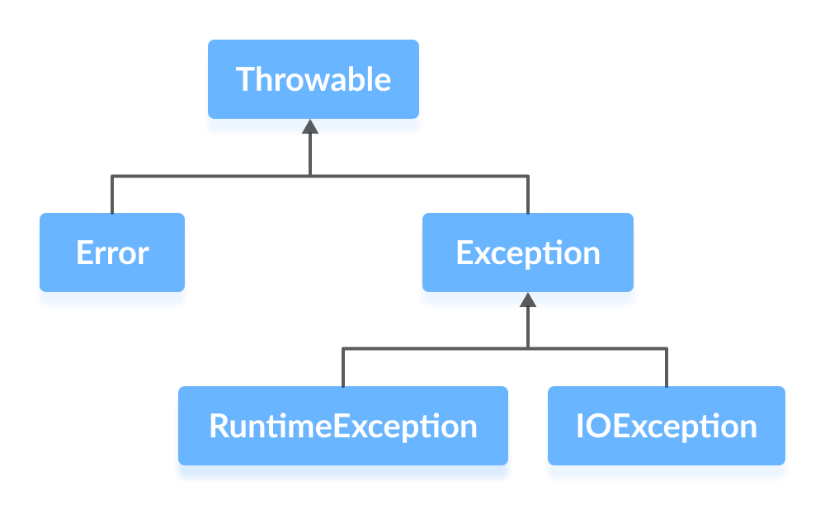
An exception can occur for many reasons. Some of them are:
Invalid user input
Device failure
Loss of network connection
Physical limitations (out of disk memory)
Code errors
Opening an unavailable file
Java Exception hierarchy
As you can see from the image, the Throwable class is the root class in the hierarchy.
Note that the hierarchy splits into two branches: Error and Exception.

Slide 39
Errors
Errors represent irrecoverable conditions such as Java virtual machine (JVM) running out of memory, memory leaks, stack overflow errors, library incompatibility, infinite recursion, etc.
Errors are usually beyond the control of the programmer and we should not try to handle errors. Ex: LinkageError, VirtualMachineError.
Exceptions
Exceptions can be caught and handled by the program.
When an exception occurs within a method, it creates an object. This object is called the exception object.
It contains information about the exception such as the name and description of the exception and state of the program when the exception occurred.
Java Exception Types
The exception hierarchy also has two branches: RuntimeException and IOException.

Slide 40
1. RuntimeException
A runtime exception happens due to a programming error. They are also known as unchecked exceptions.
These exceptions are not checked at compile-time but run-time.
Some of the common runtime exceptions are:
Improper use of an API - IllegalArgumentException
Null pointer access (missing the initialization of a variable) - NullPointerException
Out-of-bounds array access - ArrayIndexOutOfBoundsException
Dividing a number by 0 - ArithmeticException
You can think about it in this way. "If it is a runtime exception, it is your fault".
The NullPointerException would not have occurred if you had checked whether the variable was initialized or not before using it.
An ArrayIndexOutOfBoundsException would not have occurred if you tested the array index against the array bounds.

Slide 41
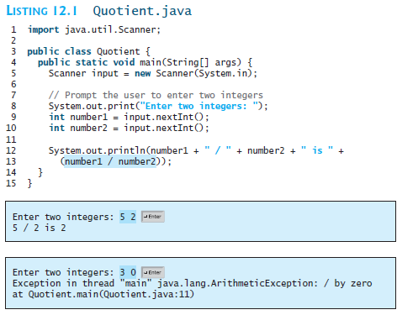
ArithmeticException

Slide 42
2. IOException
IOException (Input/Output Exception) belongs to a class of checked exception in Java that occurs during input and output operations, such as reading from a file, writing to a file, or interacting with streams.
Checked exceptions are thrown at compile time. Resolving checked exceptions is necessary to execute a Java program.
There are many subclasses of IOException, such as FileNotFoundException, SSLException, EndOfStreamException, and DirectoryNotFoundException.
Situation | Example
File not found | Trying to read a file that doesn't exist.
Error reading/writing file | Disk full, permissions error, or file is locked.
Stream interruptions | Network failures or broken pipe during stream operations.
Closing a stream or reader improperly | Forgetting to close resources or trying to read from a closed stream.

Slide 43
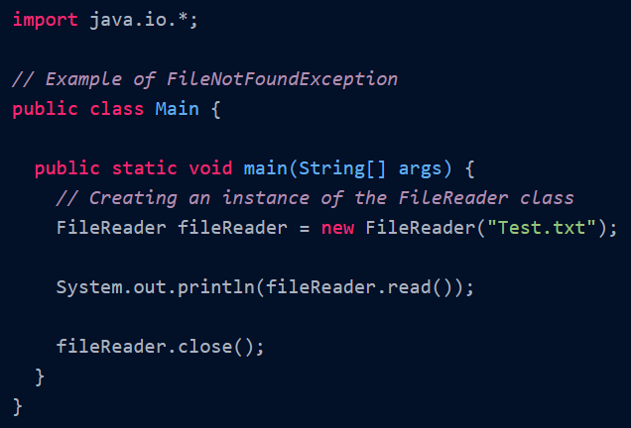

Slide 44
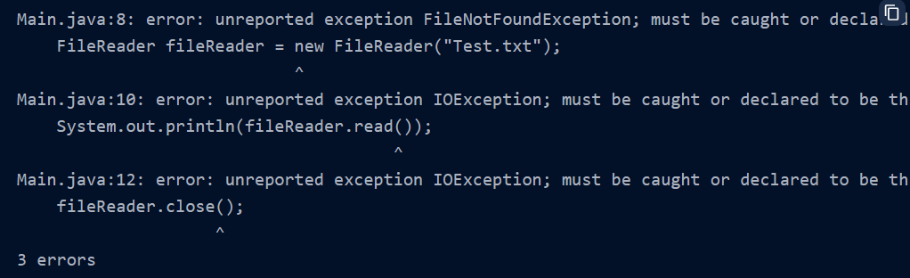
Explanation:
FileNotFoundException is thrown when compiling the above Java program. Hence, the program does not compile and cannot be executed.
This exception is thrown to avoid scenarios such as if the named file does not exist, is a directory rather than a regular file, or cannot be opened for reading for some other reason.
Apart from the close() and read() methods of the FileReader class, it also throws an IOException, which must be handled.

Slide 45
Exception Handling
We know that exceptions abnormally terminate the execution of a program.
This is why it is important to handle exceptions. Here's a list of different approaches to handle exceptions in Java.
Different approaches to handle exceptions in Java.
try...catch block
finally block
throw and throws keyword

Slide 46
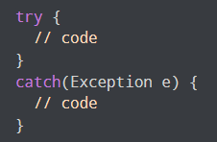
1. Java try...catch block
The try-catch block is used to handle exceptions in Java.
Here, we have to place the code that might generate an exception inside the try block.
Every try block is followed by a catch block.
When an exception occurs, it is caught by the catch block. The catch block cannot be used without the try block.

Slide 47
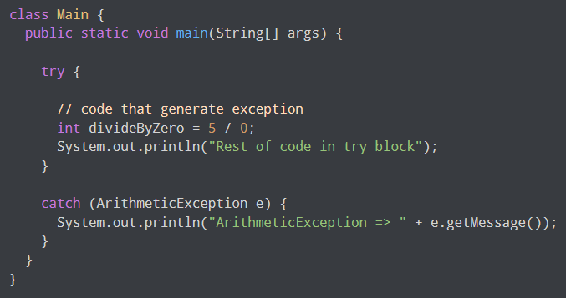
Ex: Exception Handling using try…catch
The classes used (System, ArithmeticException, etc.) are part of the java.lang package.
java.lang is imported by default in every Java program, so there's no need for manual import.
Output: ArithmeticException => / by zero
To handle the exception, we have put the code, 5 / 0 inside the try block. Now when an exception occurs, the rest of the code inside the try block is skipped.
The catch block catches the exception and statements inside the catch block is executed.
If none of the statements in the try block generates an exception, the catch block is skipped.

Slide 48
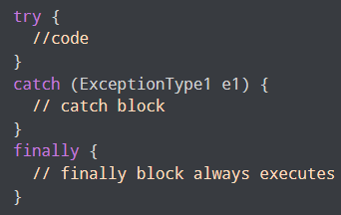
2. Java finally block
The finally block is always executed no matter whether there is an exception or not.
The finally block is optional. And, for each try block, there can be only one finally block.
If an exception occurs, the finally block is executed after the try...catch block. Otherwise, it is executed after the try block.
Syntax:

Slide 49
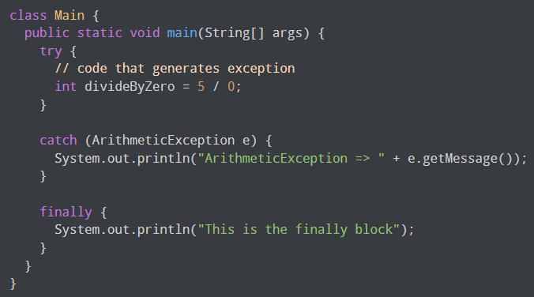

Ex: Exception Handling using finally
We are dividing a number by 0 inside the try block. Here, this code generates an ArithmeticException.
The exception is caught by the catch block. And, then the finally block is executed.
Note: It is a good practice to use the finally block, because it can include important cleanup codes.

Slide 50
3. Java throw and throws keyword
The Java throw keyword is used to explicitly throw a single exception.
When we throw an exception, the flow of the program moves from the try block to the catch block. We use the throw keyword within a method.
Syntax: throw throwableObject;
public class Main{ static int division(int number1, int number2){ if (number2 == 0) { throw new ArithmeticException("Divisor should not be 0"); }else { System.out.println("Both numbers are correct!!"); return number1/number2; } public static void main(String args[]){ int res=division(12,0); System.out.println(res); System.out.println("Continue..."); }}
Exception in thread "main" java.lang.ArithmeticException: Divisor should not be 0
In this example, we are explicitly throwing the ArithmeticException using the throw keyword.

Slide 51
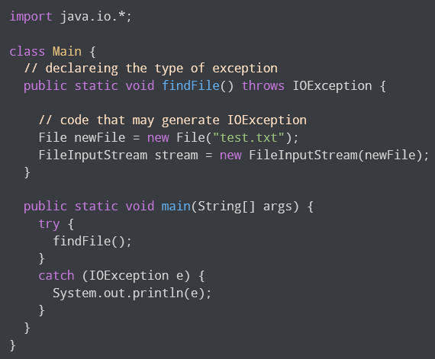
Similarly, the throws keyword is used to declare the type of exceptions that might occur within the method declaration.
Syntax: accessModifier returnType methodName() throws ExceptionType1, ExceptionType2 … { // code } -→ we can use throws to declare multiple exceptions.
When we run this program, if the file test.txt does not exist, FileInputStream throws a FileNotFoundException which extends the IOException class.
The findFile() method specifies that an IOException can be thrown. The main() method calls this method and handles the exception if it is thrown.
If a method does not handle exceptions, the type of exceptions that may occur within it must be specified in the throws clause.

Slide 52
import java.util.*; // Handling multiple exceptions class JavaThrows { public float ThrowsExample(int a, int b, int n) throws ArithmeticException, ArrayIndexOutOfBoundsException { if (n < 3) { throw new ArrayIndexOutOfBoundsException("Array length must be at least 3"); } float arr[] = new float[n]; arr[0] = a; arr[1] = b; if (b == 0) { throw new ArithmeticException("Divisor should not be 0"); } arr[2] = a / b; return arr[2]; } public static void main(String arg[]) { Scanner obj = new Scanner(System.in); System.out.print("Enter value for a: "); | int d1 = obj.nextInt(); System.out.print("Enter value for b: "); int d2 = obj.nextInt(); System.out.print("Enter array length: "); int len = obj.nextInt(); JavaThrows jt = new JavaThrows(); try { float res = jt.ThrowsExample(d1, d2, len); System.out.println("Division of " + d1 + " and " + d2 + " is " + res); } catch (ArithmeticException e1) { System.out.println("Division by zero is not possible!!"); } catch (ArrayIndexOutOfBoundsException e2) { System.out.println("Index out of range!!! " + e2.getMessage()); } }}
Enter value for a: 5
Enter value for b: 0
Enter array length: 3
Division by zero is not possible!!
Enter value for a: 5
Enter value for b: 2
Enter array length: 2
Index out of range!!! Array length must be at least 3

Slide 53
Nested Try Block
A try block can be nested within another try block. This structure is termed as Nested try block. Whenever an exception is raised within a nested try block, its exception is pushed to Stack. The exception propagates from child to parent try block and so on.
For example, the inner try block can be used to handle ArrayIndexOutOfBoundsException while the outer try block can handle the ArithemeticException (division by zero).
Why use nested try block
Sometimes a situation may arise where a part of a block may cause one error and the entire block itself may cause another error. In such cases, exception handlers have to be nested.

Slide 54
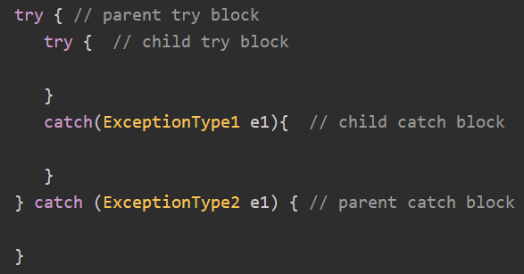

Slide 55
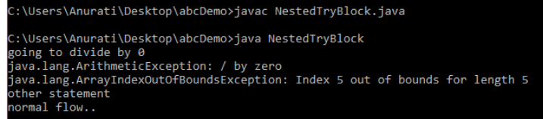
Nested try block example
public class NestedTryBlock{ public static void main(String args[]){ try{ //outer try block try{ //inner try block 1 System.out.println("going to divide by 0"); int b =39/0; } //catch block of inner try block 1 catch(ArithmeticException e) { System.out.println(e); } try{ //inner try block 2 int a[]=new int[5]; //assigning the value out of array bounds a[5]=4; // tries to assign value to index 5, which is out of bounds } | //catch block of inner try block 2 catch(ArrayIndexOutOfBoundsException e) { System.out.println(e); } System.out.println("other statement"); } //catch block of outer try block catch(Exception e) { System.out.println("handled the exception (outer catch)"); } System.out.println("normal flow.."); } //main fucnt } // Class ends

Slide 56
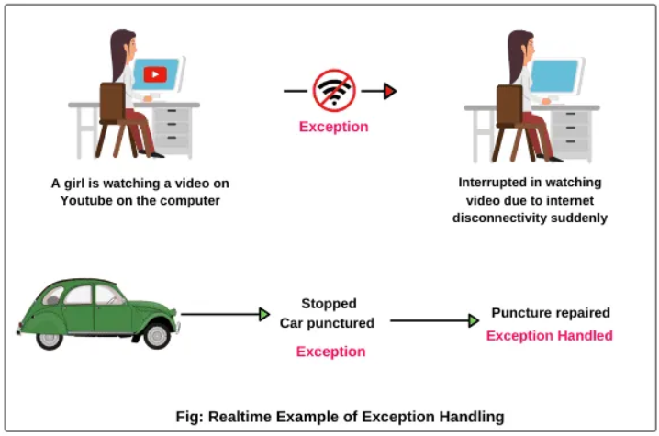
Custom Exceptions:
In Java, we can create our own exceptions that are derived classes of the Exception class.
Creating our own Exception is known as custom exception or user-defined exception.
Basically, Java custom exceptions are used to customize the exception according to user need.
Consider creating custom exceptions for specific application scenarios.
Custom exceptions can provide more meaningful information about the error.

Slide 57
import java.util.ArrayList; import java.util.Arrays; // create a checked exception class CustomException extends Exception { public CustomException(String message) { // call the constructor of Exception class super(message); }} class Main { ArrayList<String> languages = new ArrayList<>(Arrays.asList("Java", "Python", "JS")); // check the exception condition public void checkLanguage(String language) throws CustomException { // throw exception if language already present in ArrayList if(languages.contains(language)) { throw new CustomException(language + " already exists"); } | else { // insert language to ArrayList languages.add(language); System.out.println(language + " is added to the ArrayList"); } } public static void main(String[] args) { // create object of Main class Main obj = new Main(); // exception is handled using try...catch try { obj.checkLanguage("Swift"); obj.checkLanguage("Java"); }catch(CustomException e) { System.out.println("[" + e + "] Exception Occured"); } }} Output: Swift is added to the ArrayList [CustomException: Java already exists] Exception Occured

Slide 58
Exception Handling in OOAD (Object-Oriented Analysis and Design):
In Object-Oriented Analysis and Design (OOAD), exception handling is considered during the design phase to ensure that the system can gracefully handle and recover from errors at runtime.
The design might involve defining custom exception classes that represent specific error scenarios within the system.
Exception handling design also considers how error information is propagated and reported to users or other parts of the system.

Slide 59
Inner Class
Java inner class or nested class is a class that is declared inside the class or interface.
We use inner classes to logically group classes and interfaces in one place to be more readable and maintainable.
Additionally, it can access all the members of the outer class, including private data members and methods.
Syntax:
class Java_Outer_class{ //code class Java_Inner_class{ //code } // inner } // outer

Slide 60
Types of Inner Classes
Non-static Nested Class (Inner Class): Associated with an instance of the outer class.
Static Nested Class: Not associated with an instance of the outer class and can access only static members of the outer class.
Local Inner Class: Defined within a block, typically a method.
Anonymous Inner Class: A class without a name, used to instantiate objects with certain "on-the-fly" functionality.
When to Use Which?
Inner Class: When the class is tightly coupled to the outer class (e.g., Tree and Node).
Static Nested Class: When you need a helper class but don’t need outer instance access.
Local/Anonymous: For short-lived, one-off implementations (e.g., GUI event handlers).

Slide 61
1. Non-static Nested Class (Inner Class)
Definition: A class defined inside another class without the static keyword.
Association: Each instance is tied to an instance of the outer class.
Access: Can access all members (even private) of the outer class.
Use Case: Used when the inner class logically belongs to the outer class (e.g., Engine is part of Car).
class OuterClass {
private String message = "Hello from Outer Class";
class InnerClass {
void display() {
System.out.println(message);
} } // inner class
public static void main(String[] args) {
OuterClass outer = new OuterClass();
OuterClass.InnerClass inner = outer.new InnerClass();
inner.display();
} } // outer class
Output
Hello from Outer Class

Slide 62
2. Static Nested Class
Definition: A class defined inside another class with the static keyword.
Association: Not tied to any instance of the outer class (like a regular top-level class).
Access: Can only access static members of the outer class.
Use Case: Used when the nested class doesn't need access to instance-specific data.
class OuterClass {
private static String message = "Hello from Static Nested Class";
static class StaticNestedClass {
void display() {
System.out.println(message);
} }
public static void main(String[] args) {
OuterClass.StaticNestedClass nested = new OuterClass.StaticNestedClass();
nested.display();
} }
Here, It can access the static members of OuterClass directly. No instance of OuterClass is needed to create an instance of StaticNestedClass.
Output
Hello from Static Nested Class

Slide 63
3. Local Inner Class
Definition: A class defined inside a block (e.g., a method, loop, or if statement).
Scope: Only visible within the block where it’s defined.
Access: Can access final or effectively final local variables of the enclosing block.
Use Case: Used for one-off implementations.
class Outer {
void outerMethod() {
final int localVar = 30;
class LocalInner {
void display() { / / Must be final or effectively final
System.out.println("Access local variable: " + localVar);
} }
LocalInner inner = new LocalInner();
inner.display();
} // outerMethod
public static void main(String[] args) {
Outer outer = new Outer();
outer.outerMethod();
} } // outer class
Output
Access local variable: 30

Slide 64
4. Anonymous Inner Class
Definition: A class without a name, defined and instantiated in a single expression.
Use Case: Used for quick implementations of interfaces or abstract classes.
Syntax: Uses new InterfaceName() { ... } or new ClassName() { ... }.
interface Greeting {
void greet();
}
class Outer {
void anonymousDemo() {
Greeting greeting = new Greeting() { // Anonymous class implementing Greeting
public void greet() { // @Override
System.out.println("Hello from anonymous class!");
}};
greeting.greet();
}
public static void main(String[] args) {
Outer outer = new Outer();
outer.anonymousDemo();
} }
Output
Hello from anonymous class!

Slide 65
Summary
Use Sparingly: Inner classes can make code harder to read if overused. Use them when they logically belong to the outer class.
Anonymous Classes: Ideal for implementing interfaces or abstract classes with a small amount of functionality.
Accessing Members: Inner classes can access all members of the outer class, including private members, making them useful for encapsulation.
Static Nested Classes: Use when the nested class does not require access to the outer class's instance members.
Avoid Complexity: Keep inner classes simple to avoid increasing the complexity of the outer class.

Slide 66
class CPU { double price; // nested class class Processor{ // members of nested class double cores; String manufacturer; double getCache(){ return 4.3; } } // nested protected class protected class RAM{ // members of protected nested class double memory; String manufacturer; double getClockSpeed(){ return 5.5; } } } | public class Main { public static void main(String[] args) { // create object of Outer class CPU CPU cpu = new CPU(); // create an object of inner class Processor using outer class CPU.Processor processor = cpu.new Processor(); // create an object of inner class RAM using outer class CPU CPU.RAM ram = cpu.new RAM(); System.out.println("Processor Cache = " + processor.getCache()); System.out.println("Ram Clock speed = " + ram.getClockSpeed()); } } Output: Processor Cache = 4.3 Ram Clock speed = 5.5

Slide 67
Inner Classes in OOAD (Object-Oriented Analysis and Design):
In Object-Oriented Analysis and Design (OOAD), inner classes might not be as prominent as in programming languages. However, the concept of encapsulation and modular design that inner classes provide aligns with OOAD principles. The idea of grouping related classes together and managing their visibility is consistent with good design practices.
Inner classes can be used in OOAD to model relationships where one class plays a supporting or auxiliary role to another class. For example, a Student class might have an inner class representing a ContactInformation object that encapsulates email addresses, phone numbers, etc.

Slide 68
Java String
In Java, string is basically an object that represents sequence of char values. An array of characters works same as Java string. The java.lang.String class is used to create a string object.
char[] ch={‘A',‘M',‘R',‘I',‘T',‘A'};
String s=new String(ch); → is same as: String s=“AMRITA";
Java String class provides a lot of methods to perform operations on strings such as compare(), concat(), equals(), split(), length(), replace(), compareTo(), intern(), substring() etc.
The java.lang.String class implements Serializable, Comparable and CharSequence interfaces.
The CharSequence interface represents a sequence of characters. It is implemented by the String, StringBuffer, andStringBuilderclasses. This means we can create and manipulate strings in Java using any of these three classes.
In Java, String objects are immutable, meaning their values cannot be changed after creation. When a string is modified, a new object is created in memory.
Note: To work with mutable strings (i.e., strings that can be modified without creating new objects), use the StringBuffer or StringBuilder classes.

Slide 69
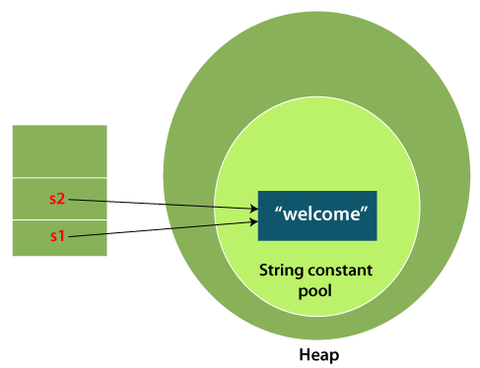
String object can be created in two ways: 1. By string literal 2. By new keyword
1) String Literal
Java String literal is created by using double quotes.
Syntax: <String_Type> <string_variable> = "<sequence_of_string>";
String s="welcome";
Each time you create a string literal, the JVM checks the "string constant pool" first. If the string already exists in the pool, a reference to the pooled instance is returned. If the string doesn't exist in the pool, a new string instance is created and placed in the pool.
For example: String s1="Welcome";
String s2="Welcome"; //It doesn't create a new instance
Note: String objects are stored in a special memory area known as the "string constant pool".
Why Java uses the concept of String literal?
To make Java more memory efficient (because no new objects are created if it exists already in the string constant pool).

Slide 70
2) By new keyword
String s=new String("Welcome"); //creates two objects and one reference variable
In such case, JVM will create a new string object in heap memory, and the literal "Welcome" will be placed in the string constant pool. The variable s will refer to the object in a heap.
Java String class methods
public class StringExample{ public static void main(String args[]){ String s1="java"; char ch[]={'s','t','r','i','n','g','s'}; String s2=new String(ch); String s3=new String("example"); System.out.println(s1); System.out.println(s2); System.out.println(s3); }}
The java.lang.String class provides many useful methods to perform operations on sequence of char values.
Output:
java strings example

Slide 71
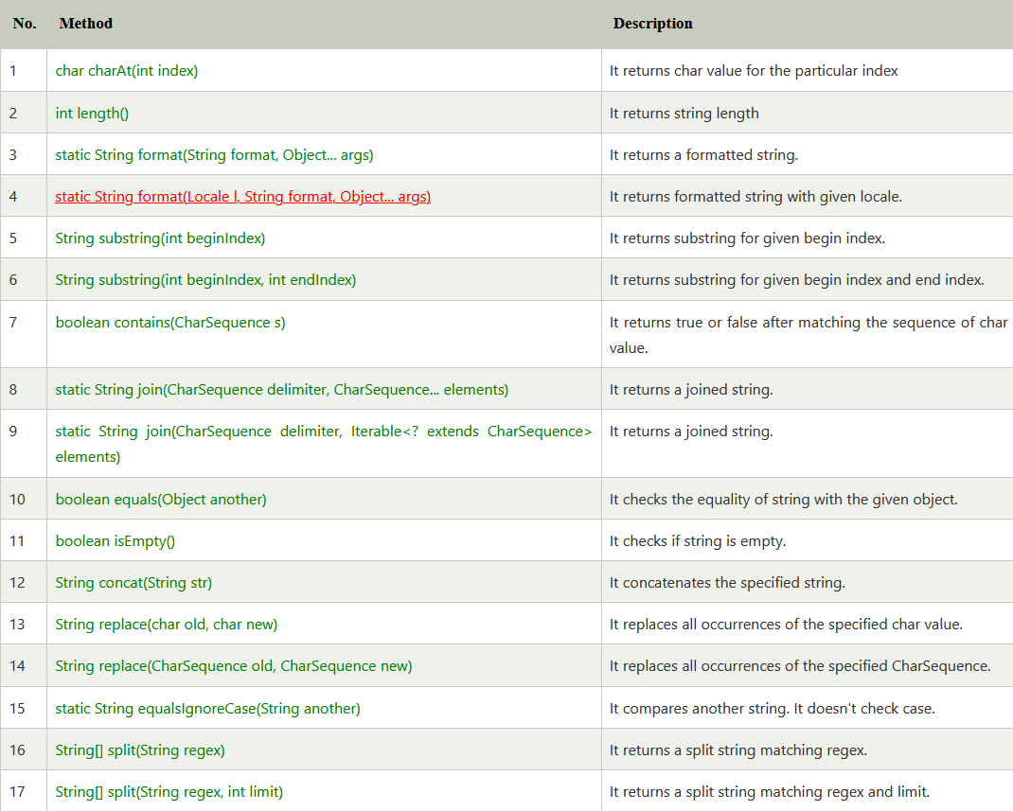
Java String class methods

Slide 72
String length() - The length() method finds the length of a string. The length of the Java string is the same as the Unicode code units of the string.
String concat() - The concat() method appends (concatenate) a string to the end of another string.
String equals() - The equals() method compares two strings, and returns true if the strings are equal, and false if not.
import java.lang.String; public class LengthExample{ public static void main(String args[]){ String s1="java"; String s2="python"; System.out.println("string length is: "+s1.length()); System.out.println("string length is: "+s2.length()); }} Output: | import java.lang.String; public class Main { public static void main(String[] args) { String myStr1 = "Adithya "; String myStr2 = "Ram"; String myStr3 = "Ram"; System.out.println(myStr1.concat(myStr2)); System.out.println(myStr1.equals(myStr3)); System.out.println(myStr2.equals(myStr3)); }}
string length is: 4 string length is: 6 | Output: Adithya Ram false true

Slide 73
// The Java String class substring() method returns a part of the string. public class PasswordMaker { public static void main(String[] args) { String firstName = "Raj"; String middleName = "Kumar"; String lastName = "Batchu"; int age = 32; // extract initials String initials = firstName.substring(0,1) +middleName.substring(0,1) +lastName.substring(0,1); // append age after changing the initials to lower case String password = initials.toLowerCase() + age; System.out.println("Your Password = " + password); }} Output: Your Password = rkb32

Slide 74
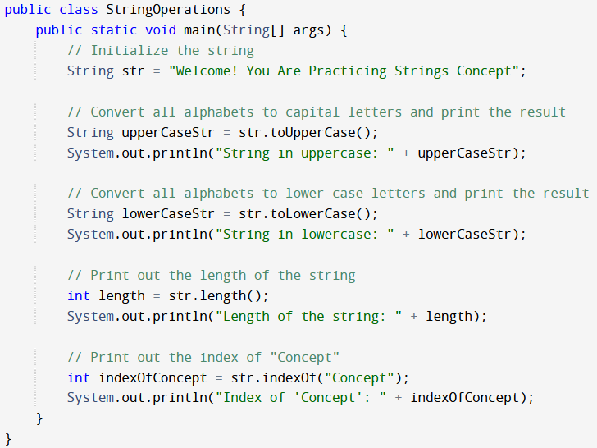
Output:
String in uppercase: WELCOME! YOU ARE PRACTICING STRINGS CONCEPT
String in lowercase: welcome! you are practicing strings concept
Length of the string: 43
Index of 'Concept': 36

Slide 75
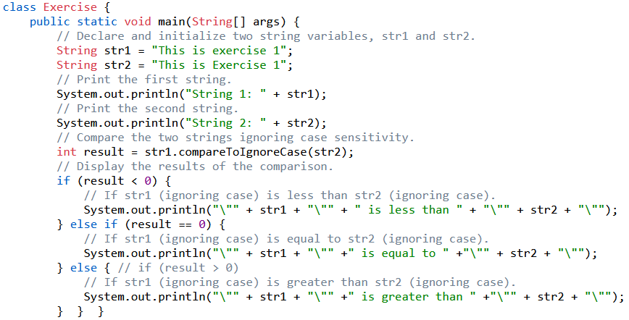
The compareTo method is used to compare two strings lexicographically. It returns:
I. A negative value if the first string is smaller. II. Zero if both strings are equal.
III. A positive value if the first string is larger.
Output:
String 1: This is exercise 1
String 2: This is Exercise 1
"This is exercise 1" is equal to "This is Exercise 1"

Slide 76
StringBuilder Class:
The StringBuilder class in Java provides a mutable sequence of characters.
It allows efficient manipulation of strings without creating new objects for each operation.
StringBuilder is often used when there are a lot of string concatenations or modifications in a loop to avoid excessive object creation.
Syntax: StringBuilder sb = new StringBuilder();
Important Constructors of StringBuilder class
Constructor | Description
StringBuilder() | It creates an empty String Builder with the initial capacity of 16 characters.
StringBuilder(String str) | It creates a String Builder with the specified string.
StringBuilder(int length) | It creates an empty String Builder with the specified capacity as length.

Slide 77
// The StringBuilder append() method concatenates the given argument with this String. class StringBuilderExample{ public static void main(String args[]){ StringBuilder sb=new StringBuilder("Hello "); sb.append("Java"); //now original string is changed System.out.println(sb); //prints Hello Java } } Output: Hello Java
// The StringBuilder insert() method inserts the given string with this string at the given position. class StringBuilderExample2{ public static void main(String args[]){ StringBuilder sb=new StringBuilder("Hello "); sb.insert(1,"Java"); //now original string is changed System.out.println(sb); //prints HJavaello } } Output: HJavaello
// The reverse() method of StringBuilder class reverses the current string. class StringBuilderExample5{ public static void main(String args[]){ StringBuilder sb=new StringBuilder("Hello"); sb.reverse(); System.out.println(sb);//prints olleH } } Output: olleH

Slide 78
Example Program using StringBuilder(int length)
public class StringBuilderExample { public static void main(String[] args) { // Create a StringBuilder with initial capacity of 50 characters StringBuilder sb = new StringBuilder(50); // Append some strings sb.append("Hello"); sb.append(" "); sb.append("World!"); // Output the result System.out.println("StringBuilder content: " + sb.toString()); // Display the current capacity System.out.println("Current capacity: " + sb.capacity()); // Display the current length of the string System.out.println("Current length: " + sb.length()); }}
Output: StringBuilder content: Hello World! Current capacity: 50 Current length: 12

Slide 79
Differences Between String and StringBuilder
String:
Immutable- String objects are immutable, meaning once a String object is created, it cannot be modified. Any modification to a String results in the creation of a new String object
thread-safe - String is inherently thread-safe because it is immutable. Multiple threads can access a String object concurrently without synchronization issues.
less efficient for frequent modifications.
StringBuilder:
Mutable- objects are mutable, meaning they can be modified without creating new objects. This allows for efficient modifications, especially when performing multiple concatenations or other string manipulations.
not thread-safe - StringBuilder is not thread-safe. If multiple threads access a StringBuilder instance concurrently, and at least one thread modifies it, external synchronization is required.
more efficient for frequent modifications.

